Slide 1
‘Transitions to the Max’
Safeguarding & Transitions, Adults and Children, Pan Bedfordshire Development Day
03 October 2023 – The Rufus Centre - Flitwick

Slide 2
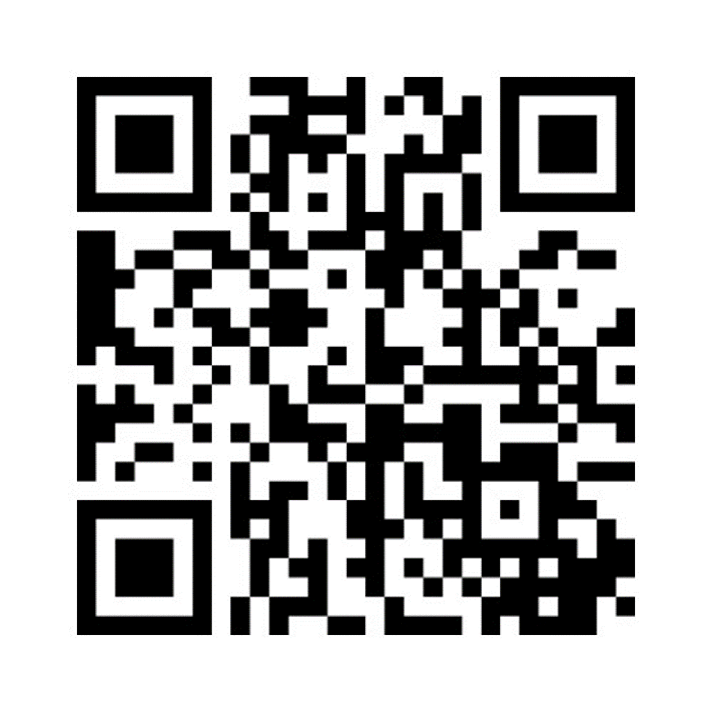
Housekeeping:
Event Timings: Break 11:15am (20 mins) Lunch 1pm (45mins) Close 4pm
Toilets: back of hall & in foyer area
Fire alarm/ evacuation: No drill expected. If a loud alarm sounds, please leave by nearest exits and meet in the car park
Engagement: There will be opportunities for a Q&A with the panel during the event.
Please log in to Menti and answer the questions
During group discussions, please nominate a note taker. Please ensure all notes from group discussions are left on your table; these will be collected by the SAB and collated following today’s event.
Go to Menti.com & enter the code: 14661116

Slide 3
Welcome and Introductions: Maud O’Leary (SAB- CBC/BBC Independent Chair)
Welcome
Why are we here?
MENTI POLL: What outcomes do we individually want from today?
What role can each of us play in ensuring change?
How will we measure our individual and collective success in delivering on the Max SAR recommendations?

Slide 4
“Sometimes you have to do something because its the right thing to do.” – Fran Leddra, Chief Social Worker, Bridging The Gap
Maud O’Leary – A couple of quotes:
“Everyone thinks of changing the world, but no-one thinks of changing themselves.” – Leo Tolstoy

Slide 5
Safeguarding Adult Review ‘Max’
The next challenge: How to measure success

Slide 6
Pen Picture of Max
Max was an 18 year old White British man who had been adopted in infancy, who was described as a mischievous, ‘smashing young man’, a free spirit who could be very kind. He was passionate about music and extremely talented, able to play any song by memory and generously helped other young people on his music course with their work.
The description of Max as having ‘high functioning’ autism may have been misleading to professionals working with him. Although Max was not learning disabled, his full-scale IQ had been assessed 73, which placed him on the borderline of learning needs. Certainly, his autism and anxiety made it more difficult for Max to understand his place in the world and he had poor impulse control due to attention deficit hyperactivity disorder which contributed to poor decisions.
Max lacked insight into the intentions and motivations of others, which made it difficult for him to make or sustain friendships, but his desperate longing to belong meant that he was very vulnerable to those who could exploit him. This was likely exacerbated by the lengthy period he was out of mainstream education from the age of 16, placed by himself in a residential unit under 2-1 supervision, without the opportunity to develop his social skills.

Slide 7
Key events
The sexual risk Max posed to other young people, combined with the fact that he did not have a learning disability or severe mental health diagnosis meant that there was a lack of clarity about which adult service was responsible for assessing his care needs, consequently these were still not assessed by his 18th birthday.
Options for accommodation were therefore extremely limited, although Children’s Services delayed moving him from his residential unit for several months after his 18th birthday while they continued this search, but eventually he moved into a private tenancy with no care plan or risk assessment in place.
Max immediately started using drugs and his drug use escalated extraordinarily quickly, likely aggravated by his poor impulse control and self-medication to manage the unboundaried situation he found himself in. He was repeatedly admitted to mental health wards during periods of crisis, but was released because he was not detainable for treatment under the Mental Health Act 1983.
Delays in coordinating the multi-agency response meant that efforts to mitigate the escalating risk were fragmented and lacked leadership. Max was tragically found dead of an accidental overdose in his flat on 22 May 2020.

Slide 8
Transition from Children’s to Adult Services and care pathways for neurodiverse young people
Gaps in collaborative assessment and planning for Max’s transition and rigid application of ‘eligibility’ criteria for individual services meant that no adult services were in place at the point Max turned 18 despite his unquestionably complex needs.
Pathways to secure a timely assessment of Max’s care and supports needs were opaque and overreliance on services designed to provide ‘life skills’ support impeded preventative work to stop risks from escalating.
A clear pathway is needed for young people with autism transitioning to adulthood across Bedfordshire, irrespective of their level of functioning, across Children and Adults’ mental health and social care, with specialist services that can meet the assessed needs.

Slide 9
Housing options for young people transitioning to adult services
Limited options for specialist accommodation resulted in Max moving to private accommodation that could not meet his needs in the absence of an effective care plan. There is a clear need for specialist placements or, in the interim, greater flexibility from commissioners locally to use powers under National Health Service Act 2006, Mental Health Act 1983 and Care Act 2014 to provide accommodation based support that is needs-led rather than diagnosis-led.

Slide 10
Mental health, mental capacity and risk management
Siloised working between mental health and social care resulted in practitioners taking entrenched positions in respect of each agencies’ analysis of Max’s needs, functioning and mental capacity.
This was exacerbated by the sheer number of agencies involved, without any taking a leadership or coordinating role and incompatible ICT systems hindering information sharing. Although agencies eventually resolved this and started to work in a collaborative and strategic way to care plan and manage risk, this delay had allowed Max’s needs to spiral dangerously.
The bureaucracy of arranging complex care plans further hindered efforts to provide an agile response to the escalating crisis. This fragmented approach also meant that clinicians from the mental health ward were not integrated in safeguarding planning.

Slide 11
Response to exploitation
The overwhelming urgency of resolving Max’s needs for specialist care and support drew focus from the issue of exploitation, resulting in a limited multi-agency safeguarding response.
An all-ages approach to exploitation should be developed ensure that pathways, tools and training are available to all practitioners working with people experiencing exploitation, with a particular focus on embedding knowledge for practitioners working with younger adults who have transitioned from children’s to adults’ services.
This requires legal literacy in respect of frameworks for intervention and an effective multi-disciplinary strategic approach.

Slide 12
Actions and changes by CBC Adults services
Transitions to the Max
Stuart Mitchelmore
Assistant Director Adult Social Care

Slide 13
Today support would have not stalled whilst organisations agree who is responsible.
A review of the Multi-agency Co-operation between Teams protocol shared & implemented involving CBC Adults, Bedford Borough Council (BBC), Children’s services and East London Foundation Trust (ELFT).
The dispute resolution protocol includes a commitment from all parties that the initial point of entry will hold the case until safe transfer to the appropriate agency/team is arranged.
Document shared & Launch events in October.

Slide 14
The terms of reference (ToR) for the Transitions Meeting (formerly termed panel) has been reviewed and circulated across partners. The difference now is that membership has increased the great importance of this meeting has been highlighted to SEND service.
The monthly transitions meeting is now regularly attended by Adult Mental health services as well as Child and Adolescent Mental Health services (CAMHs) and Adult Social Care services and Children services.
This enables that all services now to be involved in discussions earlier & disputes would be recognised and resolved sooner.

Slide 15
Joint transitions audits have been undertaken with Children services & more are scheduled and planned for on a quarterly basis going forward. It involves practitioners and managers and appropriate agencies involved so feedback can be captured and addressed.
Audits done to date have shown good multidisciplinary working around the adult resulting in good outcomes. Adult and children services have seen more flexibility in care planning because of the learning of MAX SAR.
This allows for monitoring of practice & the opportunity to learn from cases at an early stage and amend practice, policy & procedure where needed.

Slide 16
Risk Enablement Practice Guidance & Panel procedure CBC (adult & Children) updated and distributed internally & to all partners agencies. Uploaded to the Policy Hub, shared and discussed with practitioners.
The Social Care Specification with ELFT describes the delegated functions and is being currently finalised. There will be reference to transitions within this.

Slide 17
An Accommodation Strategy for adults with care and support needs (working age adults) has been created spanning 2022-2027.
The strategy sits with the Commissioning Service, looking to increase provision by 20% and includes supported living supply. Looking to replace existing stock that is poor quality & will include provision for people with a learning disability and autism.
The strategy will increase capacity for short break units including provision for people with a learning disability and autism.

Slide 18
To improve services and collaborative approaches between looked after Children (LAC)/ELFT/Housing/Children services, Housing now sitting on the Corporate Parenting Panel.
Housing & Children’s Services protocol is in progress & will include a housing pathway for care experienced young people immediately leaving care. As it involves multiple pathways, where children services and housing duties interact beyond care experienced young people (finalised by the end of 2023).
Housing have opened up training flats (semi-independent) Houghton Regis area, to provide a safe environment to learn how to live independently. The protocol will be further expanded to include Adult social care processes where there are potential care needs.

Slide 19
The protocol will also include how housing support Children services with ‘light-touch’ suitability assessments when properties within the private rented sector are being considered. Will open up pathways for Colleagues in Children’s to have improved access to supported housing provision.
Housing service is developing a supported accommodation strategy that will include considering the needs of homeless people with mental health problems and exploring potential responses in collaboration with health and adult social care, towards people with mental health problems that fall below the threshold for supported living. Potential to reduce the number of out of area placements, as this has a negative impact by creating barriers to the persons family & local support networks often leading to failed placements.
Project recently set up to review all short breaks options including out of area and will aim to address issues including out of area placements.

Slide 20
To widely publicise the multi-agency exploitation strategy, training, and tools and to facilitate an all-ages approach to tackling exploitation, two Exploitation Practice surgeries held by Lisa Robinson (Police exploitation Lead) to Adult and Children Practitioners.
The Ripfa “Good Practice Guidance on transitional safeguarding” circulated to all practitioners in CBC. Transitional safeguarding training course and Eligibility and Human rights training to be facilitated by L&D team
Workers from Adults and Children’s Services attended a Transitional Safeguarding webinar (provided by LGA) discussed to embed learning & managers have also been asked to share their learning in their teams.

Slide 21
Moving Forward
Much progress on learning from the MAX SAR
Our services will continue to monitor practice through transition audits and act & learn actively as a result
Accommodation strategy & offer will continue to expand the breath of options available to people closer to home
Continue to work with all partner agencies to improve the system and pathways and collegiate approaches

Slide 22
Central Bedfordshire Children’s Services
Ruth Coals
Head of Professional Standards and Principal Social Worker

Slide 23
Kate Walker
Director of Adults’ Services
Bedford Borough Council

Slide 24
Maggie Atkinson – Independent Chair

Slide 25
Video made by experts

Slide 26
Coffee Break - Time for Reflection and Networking 11:15-11:40

Slide 27
Transitions to the Max –ELFT Updates
East London Foundation Trust

Slide 28
What we have done…
Strategic transitions lead has been reviewing current practice and procedures in place to be able to take a view and make recommendations of how ELFT could improve future practice- this has included meeting with colleagues across Bedford and Luton.
ELFT held a transitions workshop ( across CAMH’s AMH’s and LA’s)to reiterate the importance of transitions planning for young people and to ascertain the level of confidence and understanding of the workforce in supporting young people. It was ascertained that the transitions policy wasn’t widely understood as such further work is being undertaken to communicate this to colleagues(R2)
Transitions working group in place ( including young people) to respond to the outcomes and themes of the workshop – including a transitions e-learning module, support to carers, review of DNA policy, audit (R3).

Slide 29
What we have done…..
Strategic transitions lead, CAMH’s and adult colleagues have agreed a schedule for obtaining early forecasting information – this is to support teams to identify who may require transition to adult services and to enable team managers to prompt their teams to make early referrals ( R3)
ELFT ( Beds, CBC, Luton) agreed at DMT that transitions referrals will be accepted at 17yrs of age ( previously 17.5) to enable a longer period of planning and to ensure that care and support is in place prior to a young person’s 18th birthday (R2/R3)
Co-operation between Teams protocol has been authored by CBC and ELFT and has been signed off by both CAMH’s and AMHS- we will continue to work collaboratively on communicating this to the wider system-to ensure that there is a consistent standard of practice and escalation route where there is dissent about which organisation should take the lead.(R1)

Slide 30
What we have done….
Transitions referral form has recently been developed and approved for use across BBC, CBC and Luton this is to ensure the consistency of information and early planning (R2/R3)
Strategic transitions lead has attended DMT to promote the existing transitions policy and reinforce the responsibilities of working collaboratively with children’s colleagues ahead of any transition into adult services. A further transitions event was held in July 2023 to reiterate the importance of early referral and planning, co-operation between teams protocol and consistent use of transitions referral form(R2)
Strategic transitions lead has consulted on several cases – to advise and guide on best practice and legal frameworks to secure good outcomes for young people-(R3)

Slide 31
What we have done…..
Strategic Lead for Transforming Care – Bedfordshire is in post hosted by ELFT. This role ensures that adults who are at risk of admission and have a LD or Autism are supported via the Transforming Care pathway have the appropriate CETR and support to prevent admission and or to ensure a safe and appropriate discharge ( R7)
Autism Practitioner post is being recruited for Bedford CMHT – to start in December 2023.
Monthly meetings are in place between Strategic Transitions Lead and Head of Patient Flow to ensure that support is in place for any young person on an adult ward (up to 25), and to ensure that any young person who has a diagnosis of LD/Autism is appropriately referred for support via the TCP program -CETR). This will also be an opportunity to highlight frequent admissions and ensure that a MDT is convened to assess ongoing risks and discharge plans ( R7)
Strategic transitions lead will offer some bespoke training to key staff on the wards to ensure that they are aware of TCP responsibilities, transitions and the necessary legal frameworks to ensure safe and appropriate discharge (R7)

Slide 32
Patient Safety Forum updated in May & further update due in Nov
IMPROVEMENT WORK ACROSS NORTH & SOUTH BEDS
Additional capacity Strategic Transitions Lead providing system leadership across all agencies CAMHS Transitions clinical leads for North and South Beds Transitions support workers support service users Transformation Project Manager supporting transitions working group meetings and projects | Joint working New referral form to ensure consistency in info provided & enough time for joint working and care planning Discussions on more strategic and earlier identification of YP and predominant/ primary needs 'Co-operation between teams' policy ASC pathway pilot site for accepting earlier transitions to enable Adults, LA & CAMHS to work more closely on planning Care plan template being developed for Rio which will support transitions planning in CAMHS | Supporting staff Easier to read version of ELFT transitions policy has been produced to sit alongside the policy on ELFT’s intranet Awareness raising & spotlight sessions at whole staff meetings, learning sessions & support for new starters via inductions Co-producing transitions e-learning module Practice guide on what to consider when supporting young people | Support for young adults and carers Promoting Discovery & Recovery college offer for young adults via transitions open days Co-producing content on transitions for CAMHS website Reaching out to parents/ carers via Adults People Participation and Carer Forums to be part of improvement projects | Service user experience ‘Journal of my experiences’ to support communication needs when working with multiple services Co-designing service user feedback form CAMHS working with Adults services on appointments/ discharge (FAQs; Welcome Packs) Discussions about whether Dialog + would be helpful for all transitions
Local audits undertaken in B&L with series of recommendations of which some of above is a response to. This work is in development in B&L and shared across the Directorate with plans to discuss focus and approach of future audits Trust-wide together with local audit leads. Invitation for expressions of interest for a Trust-wide audit lead has been emailed to staff.

Slide 33
Max SAR
BLMK ICB
Andrea Piggott – Head of Safeguarding

Slide 34
ENGAGEMENT WITH HEALTH PARTNERS
Recommendations and learning from Max SAR presented and disseminated to internal directorates and teams.
Individual health partners in provider services have shared recommendations and learning from Max SAR

Slide 35
SHARED LEARNING- THROUGH TRAINING
Review of ICB training offer-New Training Matrix developed
L3 Safeguarding Primary care training delivery and Bitesize sessions
10 bitesize sessions on MCA delivered across Primary care (data Jan-July 23)
Covering MCA topics and Case studies
Access to E-Learning modules
Positive feedback and discussion engagement
Adulthood transition summit held in May 2023 -two dates offered to ensure accessibility. Focus areas included-
SEND
LAC
LD and Autism
LA support 0-25year olds
Youth Justice
Physical/long term health conditions
Palliative/EoLC
CYP Mental health
Transitional Safeguarding

Slide 36
SHARED LEARNING- THROUGH TRAINING
LeDeR
To now include reviews where autism is the sole diagnosis
To include over 18 years
Under 18 years to be reviewed under CDOP process
To develop process to track themes and identified learning so to embed change

Slide 37
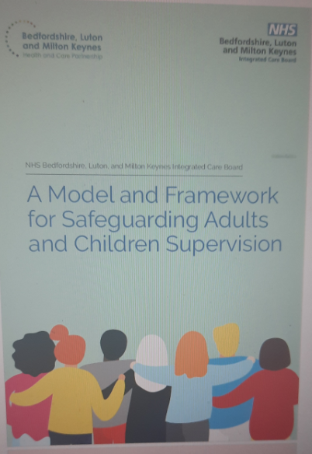
SHARED LEARNING THROUGH SUPERVISION
Launch of ICB Safeguarding Supervision framework
Internal and external offer
Tracking of themes to identify potential learning gaps

Slide 38
NDD PATHWAYS
ICS Children Transformation Board has NDD review as one of its priorities – following System scoping and workshop Board agreed 5 areas of transformation end of Feb 2023. 12-18mont work plan being developed, improving transition is a golden thread across the 5 transformation areas (Communication and training, Schools, Diagnostic pathway, Post diagnostic support and resource to identify / meet needs earlier).
Place based Joint Commissioning Intentions have ‘preparing for adulthood’ as priority areas, the joint commissioning operational groups report progress against to their Place based SEND Boards. Recommendations from the BLMK Transition summits to be taken forward at Place through this governance.
MCA-Being incorporated into SEND, Transition to Adulthood, LD, MH Dementia and EoL workstreams to ensure all parties are conversant with the law and its application

Slide 39
PRIMARY CARE-GP PRACTICE
Changes implemented within GP practice following recommendations from multi-agency action
All newly registered patients with safeguarding concerns are added to watch list and patients with active ongoing concerns are identified by admin and passed to GP for review.
Robust system in place for identifying patients with safeguarding concerns and complex needs to be referred to MDT meeting where their care is discussed with other agencies who are involved in their care.
All clinical and non-clinical staff to complete mandatory training.
All the above are now incorporated in our adult safeguarding protocol.

Slide 40
MODEL OF WORKING
ICB Safeguarding and quality team continues to offer support and advice across the system around policy and procedures and complex cases
Support listening and reflecting service user experience in pathways / policies
Joint working across the system
Transformation workstreams mapping- Target Operating Model
QI driven-measurable , impactful change

Slide 41
Table Discussion and Audience Poll
Please discuss:
In practice, what has changed?
Give any best practice examples
Discuss any ongoing challenges and barriers to improving the outcomes to Max and people like him
Please add key discussion points to Menti. Your discussion notes will be collected by the SAB team.
Audience Poll
Go to Menti.com & enter the code: 14661116

Slide 42
13:00-13:45 Lunch and networking

Slide 43
Mind the Gap: safeguarding adolescents and young adults
Dez Holmes
Director, Research in Practice
@dez_holmes

Slide 44
Mind the gap…
Care-experienced young people, including some adopted children
Young people with LD, SEND, and/or MH needs
Young people affected by extra-familial harm and/or involved in YJS
Child protection
Making Safeguarding Personal
(Credit: C. Cocker)

Slide 45
What Transitional Safeguarding is and why it is needed (Holmes, 2021)
‘safeguarding adolescents and young adults fluidly across developmental stages which builds on the best available evidence, learns from both children’s and adult safeguarding practice and which prepares young people for their adult lives’ (Holmes & Smale, 2018)
Reflects evidence that the current binary approach bears significant human and economic costs
Harm, trauma and development don’t stop at 18
Not just transition planning from CSC → ASC or CAMHS → AMHS.
Extends beyond statutory duties – holistic, creative, flexible and person-centred
Interconnectedness of harms and adversities requires a highly integrated system of support: social care, health, justice, education… whole place whole person
Safeguarding is a verb, not a noun
Systems leadership: collective, participative, boundary-spanning

Slide 46
How Transitional Safeguarding connects with the justice system (Holmes & Smith, 2022)
Justice professionals and researchers have repeatedly highlighted the high levels of trauma, neurodiversity, learning needs and impaired mental health amongst the young adult custody population (House of Commons Justice Committee, 2016).
Recent analysis regarding sentenced young people (YJB, 2020) found:
- 88% had safety and wellbeing concerns
- 75% had substance misuse concerns
- 71% had speech, language and communication needs
- 71% had mental health concerns
- 56% per cent were a current or previous Child in Need.
Criminal exploitation, peer-violence, ‘gang’ association… all highlight how binary approach to safeguarding reinforces the way people are viewed as either vulnerable or culpable, depending on their age.
Criminal exploitation guidance (Home Office, 2018) acknowledges ‘vulnerable adults’ may be victims… But vulnerability is presented as an individualistic construct, rather than situational and/or contextual. Can mean many young adults without formal care and support needs may be punished rather than protected.

Slide 47
Vulnerability and justice
 | YP in general population | YP in custody
Learning disability | 2–4% | 23–32%
Comms impairment | 5–7% | 60–90%
ADHD | 1.7–9% | 12%
Autism | 0.6–1.2% | 15%
Any head injury | 24–42% | 49–72%
Head injury (LoC) | 5–24% | 32–50%
Young adults involved in the CJS have often themselves been victims of crime. Many have a history of being exposed to violence, including in the home, abuse, neglect, bereavement relating to the deaths of parents, siblings and other close relatives, and criminal behaviour by parents and siblings. These traumatic events have frequently occurred from a very young age and, the traumatic effects may be raw.
(House of Commons Justice Committee, 2016)
Notes:
https://www.t2a.org.uk/wp-content/uploads/2016/10/justice-committee-report-on-young-adults-in-the-CJS-October-2016.pdf
Quote from Dr Gooch and Dr Treadwell submission to Cttee

Slide 48
Now I’ve left care I get really lonely. That’s a big thing for my safety I think, but no one talks about it as safeguarding. Unless you’re worried about my child, I won’t hear from you [children’s services] again.
I was in care all my life and you did keep me really safe. You wrapped me up tight in bubble wrap… but I’m 19 now and I kind of feel like I can’t move my arms.
(Aisha, care-experienced young adult)
(Max, care-experienced young adult)
I couldn’t wait to get to 18, I thought that once I was an adult everything would change. It hasn’t worked out that way. I really wish I was a kid again so that you could lock me up.
(Kelly, young adult)

Slide 49
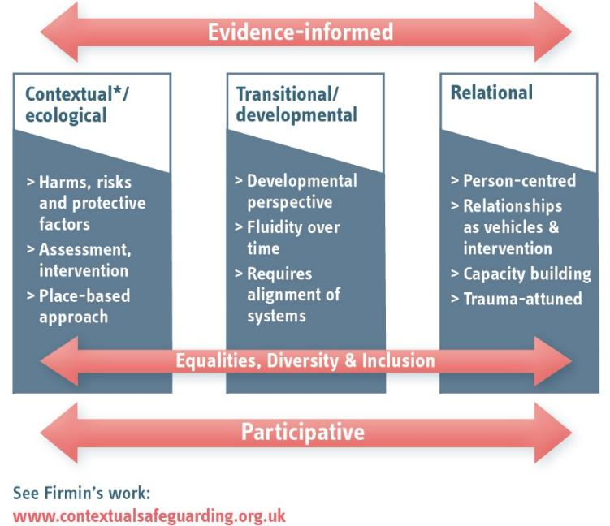
Key (non-negotiable) principles
(Holmes, 2018)
Notes:
Evidence informed requires not only research literacy, but effective local analysis capacity and mechanisms for gathering and responding to expertise form those with lived experience

Slide 50
With not to: Resilience and participation
Relationships are paramount to promoting resilience. (Coleman, 2014)
Self-efficacy - commonly associated with resilience, is an area that professionals can exercise some influence (positively or negatively!)
Children's rights to protection and participation are mutually dependent and indivisible. (UNCRC)
“[User] Involvement supports development of effective safeguarding practice, informed by people whose self-confidence, self-esteem and resilience can be developed through that involvement.” (Droy and Lawson, 2017)
‘Both/and not either/or’ (Lefevre et al, 2019)
Harm reduction principles?
(Hickle and Hallett, 2016)
YP are active partners in their own safeguarding
YP are not held responsible for their own harm
Notes:
REF - Droy, R. & Lawson, J. (2017) Making Safeguarding Personal Supporting increased involvement of service users. London Government Association and ADASS
https://www.local.gov.uk/sites/default/files/documents/25%2026%20-%20Chip_MSP%20Safeguarding%20Adults%20Boards_WEB.PDF
REF - Lefevre, M., Hickle, K. & Luckock, B. (2018) ‘Both/and’ not ‘either/or’: reconciling rights to protection and participation in working with child sexual exploitation, British Journal of Social Work, Advance Access bcy106, https://doi.org/10.1093/social/bcy106
REF - Hickle, K and Hallett, S (2016) Mitigating harm: considering harm reduction principles in work with sexually exploited young people. Children and Society, 30 (4). pp. 302-313

Slide 51
Busting myths and misconceptions
If an adult says they don’t want safeguarding support, we can’t act... This doesn’t mean we ‘walk away’ (Cooper, 2019). Making Safeguarding Personal and Transitional Safeguarding both emphasise curious, tenacious, relationship-based practice.
The CA2014 stops us from working with a person unless they have Care & Support needs… The prevention and wellbeing principles are key here (DHSC, 2020). Not all support to be safe = statutory Safeguarding
But in the eyes of the law…The law reflects common understandings at a given point in time. See CSE / marital rape.
We can’t afford to do different… We can’t afford not to…
Notes:
REF - Cooper, a. (2019). ‘Myths and realities’ about Making Safeguarding Personal. London: Local Government Association. Available at: https://www.local.gov.uk/myths-and-realities-about-making-safeguarding-personal

Slide 52
What could we do?
Deliberative learning from parts of the wider system where transitional approaches are more embedded
‘Drawing down’ best practice from safeguarding adults: rights-based approaches, MSP, wellbeing focus…Making Safeguarding Personal for young people? (Cocker et al, 2021)
Considering how Contextual Safeguarding and other innovations might inform safeguarding of young adults
Leverage the opportunities: ICS, probation, CSC review, LPS
Lean in…
The Safeguarding Adults National Network (SANN)

Slide 53
Money matters
The economic context makes innovation as difficult as it is essential.
The current approach isn’t great value…
Investing in preventative and recovery-oriented work to promote people’s safety and wellbeing can play an important role in avoiding the costs of later intervention.
Evidence from the UK and international contexts suggests that failing to help young people recover from harm and trauma can mean that problems persist and/or worsen in adulthood, creating higher costs for the public purse. (Chowdry and Fitzsimons, 2016; Kezelman et al, 2015)
The system (and the spend) is connected… Maternal wellbeing (SM, MH) and CP/care; care and criminal justice; mental health needs, costs Vs funding; family relationships and homelessness; domestic abuse and community violence etc.
Notes:
REF - Chowdry H and Fitzsimons P (2016) The cost of late intervention: Analysis. London: Early Intervention Foundation. Available online:
www.eif.org.uk/publication/the-cost-of-late-intervention-eif-analysis-2016
REF - Kezelman C, Hossack N, Stavropoulos P and Burley P (2015) The Cost of Unresolved Childhood Trauma and Abuse in Adults in Australia. Sydney: Adults Surviving Child Abuse and Pegasus Economics.

Slide 54
What’s helping local areas make the change
Clear, credible, explicitly owned local leadership of the agenda
Expansive definition of ‘partnership’ – inc communities
‘A system not a service’ - A salad not a soup
Active knowledge and skills exchange (Cocker et al, 2021)
Culture of innovation (‘the soft stuff is the hard stuff’)
Practice informed strategy
Collective, place-based problem solving (rather than problem displacement)
Building the local case – data, inc people’s lived experience

Slide 55
Safeguarding – a verb not a noun
Binary notions of child/adulthood, victims/perpetrators, vulnerability / capacity can mean some people can ‘slip through the net’ or face a ‘cliff-edge’.
Many environmental / structural factors persist into adulthood, resulting in unmet need.
Investing in preventative work to promote safety and wellbeing can help in avoiding costs (financial and human) of later intervention.
Does not propose all young adults facing risk should be protected via statutory means, nor does it propose a paternalistic approach to safeguarding young adults.
This is a systems leadership issue – Complexity, Coherence & Courage
Make it ‘a movement, not just another project’
If not now, then when? If not you, then who?

Slide 56
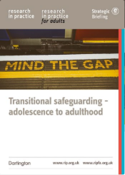
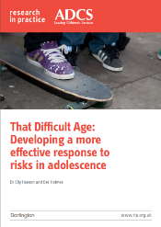
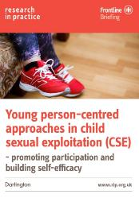
Thank you
@dez_holmes

Slide 57
Further reading
Transitional Safeguarding (2018) original briefing: https://www.researchinpractice.org.uk/all/publications/2018/august/transitional-safeguarding-adolescence-to-adulthood-strategic-briefing-2018/
The role of adult social work & adult safeguarding to the Transitional Safeguarding agenda (2021): https://www.researchinpractice.org.uk/media/5420/67346_dhsc_trans-safe-report_bridging-the-gap_web.pdf
Transitional Safeguarding and justice: https://www.justiceinspectorates.gov.uk/hmiprobation/wp-content/uploads/sites/5/2022/03/Academic-Insights-Holmes-and-Smith-RM.pdf
The relationship between Contextual Safeguarding, Complex Safeguarding and Transitional Safeguarding (2019): https://www.researchinpractice.org.uk/children/publications/2019/january/safeguarding-during-adolescence-the-relationship-between-contextual-safeguarding-complex-safeguarding-and-transitional-safeguarding-2019/
Systems leadership: https://thestaffcollege.uk/staff-college-research/systems-leadership-research/

Slide 58
Table Discussion and Audience Poll
At each layer of the local system…
What would need to STOP happening, START happening, or be STRENGTHENED / SUSTAINED for your work to reflect the messages you have heard today?
Your discussion notes will be collected by the SAB team.

Slide 59
Safeguarding Adult Review ‘Max’
The next challenge: How to measure success

Slide 60
The core question a SAB should ask after implementing a SAR action plan is “Has this work reduced the risk that this incident would happen again?”
One of the safeguarding leads who participated in the action planning review noted that Max’s SAR had the biggest impact on practice of any SAR she had ever seen, due to the commitment not just by partner agencies as organisations, but engagement by practitioners at all levels of those agencies. Although the SAR was published less than 12 months ago, the progress that has been made to date has been very impressive.
However, the challenge is in gathering the evidence to answer that those changes have resulted in a reduction in the risks to young people.

Slide 61
An action plan is a living document
Lag measures are performance indicators the demonstrate whether you’ve achieved your long-term goals of improving the safety of young people transitioning to adulthood – eg reducing the number of annual s136 and s5 MHA detentions for 18-25 year olds.
Lead measures are ‘real time’ indicators of whether you’re likely to achieve your long-term goals – eg increasing the proportion of young people accessing CAMHS who have a clear mental health transition pathway in place at 17.5years.
If your lead measures show that you are unlikely to achieve your lag measures, you should consider ‘why not’ and ‘what else is needed?’ and adjust your action plan accordingly

Slide 62
Recommendations
Too few performance indicators collected currently demonstrate safeguarding adults’ activity of partner organisations and action plans are overly focussed on outputs rather than outcomes. Given the upcoming CQC assurance framework it is important for the SAB evidence that its data collection and ability to analyse the efficacy of its safeguarding function is robust..
Recommendation 1: The current action plan should be updated with the progress of each action identified to date.
Recommendation 2: The action plan proforma should include agreed target measures providing data-driven evidence of improved outcomes and reduced risk resulting from actions. Benchmarking data in respect of these target measures should be captured in respect of cases which pre-date implementation of the changes, then a review of the actions delivered should be timetabled to evidence that positive change is sustained, or allow consideration of further improvement work if necessary.
Recommendation 3: The SAB statutory partners (local authority, health and police) should explore and agree suitable resources to ensure the SAB has adequate insight into performance measures. This should be designed so that reports are accessible for SAB members. As a minimum all SAC performance data should be provided in table/pie chart formats alongside the local authority’s demographic profile and that indicates if data is improving or worsening.

Slide 63
Recommendations
Recommendation 4: Central Bedfordshire and Bedford Borough councils should explore the feasibility of introducing some standardised safeguarding referral screening tools, guidance and methodologies for gathering SAC data etc, to enable this data to be used more effectively as a benchmarking tool against neighbouring areas and better monitor performance and local risk.
Recommendation 5: Qualitative data, such as feedback from experts by experience or parent carers and staff surveys to monitor the impact of training over time, should be used by all partners to assess the impact of improvement work. A focussed consultation should be undertaken with these stakeholders in respect of the impact of the work undertaken to improve transitions in 12 months’ time and be fed back to the SAB, with a view to identifying whether the action plan has had the intended impact, and making any changes to the action plan if required.
Recommendation 6: Each agency should keep a record of cases that have been raised through the Co-operation Between Teams protocol, identifying the nature of the dispute, the agencies involved, the timescales for a resolution and the outcome. The views of the young person in respect of timeliness, outcome, and whether the fact agencies were in dispute impacted on their care should be captured. An analysis of these cases should be fed back to the SAB after 12 months.
Recommendation 6: CBBBSAB should ensure that a clear ‘golden thread’ links the key programmes of work resulting from the action plan to the strategic priorities identified in its upcoming 2022/23 Annual Report.

Slide 64
Questions and Answers

Slide 65
Maud O’Leary – Closing Statement
What’s your pledge?
Go to Menti.com & enter the code: 14661116
Please visit Menti to make a pledge following your attendance today.

