Slide 1
Preparing for a Conversation |Prompt
Conversation Preparation Prompt – Things to think about BEFORE you make contact with the person
TYPE OF CONVERSATION
Lincolnshire Conversation/discharge conversation
Adult Care Assessment
Review
METHOD OF COMMUNICATING
Face to face
Telephone conversation
Email
Text conversation
Video - MS Teams or Zoom
Through other professionals
This tool is designed as a prompt to help you think about any actions or considerations you might want to discuss with the person you are working with to ensure any future conversations are as person centred and strengths based as possible. It is not a checklist
INDIVIDUAL CONTRIBUTION TO THE
CONVERSATION
Consider when is the best time to visit to maximise the persons contribution to the conversation. Do we need to break down information into smaller amounts. E.g more than one visit
Considering what is important to the person
Consider the impact on the persons involvement of who else (family dynamics?) / how many other people at the conversation (impact of MDT environment)
Consider what information you might give to the person in advance to maximise their involvement
Does the person need an advocate?
CONVERSATION APPROACH
Look at goals / outcomes set previously– any other services in place
What technology do they have access to? (internet, smart phone)
What network of support do they already have?
Information from contact, previous conversations and case records.
What strengths do they have that can be built upon?
Consider legal requirements (MCA, Safeguarding etc.)
CONFIRMING THE CONVERSATION WITH THE INDIVIDUAL
Have you considered:
Location and possible impact of the environment on the person.
The persons wishes
Is there anyone else they’d like to be part of the conversation?
Is work needed to build a relationship prior to the conversation?
CONVERSATION PREPARATION – Allow time to research before making contact
Gather background knowledge of the person so that they feel valued
Speak to the persons support networks e.g family/ friends.
Gathering information from other professionals. Therapy reports/ medical records/ info from medical professionals
Read previous records, hospital records and information from referral
What could the person do previously?
OTHERS CONTRIBUTION TO THE
CONVERSATION
Considering the position of others/organisations involved with the person and see their perspective. Consider how this might influence their contribution.
COMMUNICATION NEEDS
Know the persons communication needs and be prepared for different communication needs with appropriate tools (e.g language/ non verbal)
Consider verbal communication/ non-verbal communication and Communication Aids
Liaise with SALT if involved
Understand any diversity/ cultural considerations that may influence how you should communicate
RELEVANT KNOWLEDGE
Knowledge about where the person lives/how to find information about community groups/services
Knowledge of TEC
PLANNING THE CONVERSATION
Make sure you have enough time to do the conversation justice
Be Open Minded – Don’t rule anything out

Slide 2
Making Contact|Prompt Tool
Use the below structure and prompts to support you in contacting individuals and others that will input to their conversation, to get their input and set the tone of the conversation. Use this to inform the letters, emails or phone communication you have with individuals and others prior to the conversation taking place.
THE PERSON
Introduction
We will explain why we are talking to you, when and where we will talk to you and who else will be there. We will focus on how you can do as many things yourself as possible. If you have spoken to us before it might feel different to previous conversations.
Finding out more
We will find out more about you but will only talk about the things we need to know to be able to help you. Think about what is going well, what is important to you, who is important to you and what could be better in your life.
Thinking about the future
We will think about where you want to be in the future and
how you can achieve this.
Making a commitment
We will listen to you, understand what you want to do, agree things to do, who will do them and when we will do them by. We will support you to do as much as you can yourself.
Prompts to Breakdown Barriers before the Conversation
We will think about how best to understand what is happening in your life.
We will think about how you would like us to communicate with you using visuals and language.
We will think about using technology during our conversation.
We will think about where we are having a conversation and who is with you. Are you relaxed and/or happy. Is this the best time to carry on. Are there distractions.
OTHER PEOPLE
Introduction
Explain what the purpose of the conversation will be, when and
Where it is taking place and if they should attend. This will help
set the focus to be on maximising the independence of the
individual.
Finding out more
We will think about what is going well and what steps towards
independence the individual can make, themselves and/ or with
support from their family and friends.
Thinking about the future
We will think about where the individual wants to be in the
future and how they can be supported to achieve this.
Making a commitment
We will agree who will do what and by when during the
Conversation with an aim of supporting the individual retain or gain independence.
MINDSPACE EFFECTS TO CONSIDER:
MESSENGER
INCENTIVES
NORMS
DEFAULTS
SALIENCE
PRIMING/FRAMING
AFFECT
COMMITMENT
EGO

Slide 3
Using MINDSPACE to support with MCA Assessments and Best Interests Decisions
MESSENGER
Who is most appropriate to have a conversation with the person about the decision ?
Would the person have greater ability to understand information relevant to the decision if a certain person provides that information?
Has a previous effective messenger changed? Are they still the right person?
INCENTIVE
Explaining, in language appropriate to the person, what is going to happen to encourage them to be involved.
Would the person have a better chance of understanding/being engaged if a family member or someone they trust has the conversation with them
Explaining our role to support positive risk taking should the person have capacity to make decisions and talking about the benefits for the person with others.
NORMS
If challenged as to why MCA is required, using Norms to support with this explanation. It is a common and legal practice etc.
Being very clear about when a MCA would be appropriate and for what purpose (challenging the perception of some parts of the system or relatives who may think capacity is a blanket statement/state)
DEFAULTS
Ascertaining previous wishes. Are you able to use this as a "default" or the question the MCA is in regards to?
Being clear with others what any previous were and why they need to be respected
Considering the persons defaults/previous behaviours and comparing this to now.
Our default is respecting a person’s entitlement to make unwise decisions with capacity
SALIENCE
Using the persons preferred or the most effective communication method
Using appropriate explanations/ providing information that match the persons level of understanding to give them the best chance of being able to make a decision
Taking the person to a place you are speaking about/enabling them to experience what you are talking about
Use of pictures/objects to support understanding
PRIMING AND FRAMING
Discussions with the person around what is going to happen
Discussions with family, providers and informal and formal care support around what MCA is and the process that is going to be completed.
Thinking about what the specific decision is and what the person needs to know to make the decision.
REMEMBER! MCA PRINCIPLES
Assume capacity until proven otherwise
People must be supported as much as possible to make their own decisions
Right to make what others view as unwise decisions
Always do things or take decisions for people without capacity in their best interests
Consider least restrictive option or way.
AFFECT
Have they expressed any opinions in the past about the specific question? How may this impact on the MCA and conversation?
The emotional impact this may have on the person, any anxiety this may cause, do they wish to have somebody there with them to support with this?
Acknowledge the emotional impact this may have on family, especially if the outcome is not in line with what family may want for the person?
Honesty and clear explanation of perceived risk vs real risk
De-formalising the conversation
COMMITMENT
Following the outcome of the MCA, do we need commitment from others to action the decision in line with the persons wishes or in line with the BI decision?
EGO
Providing reassurance to the person about how they are doing to encourage them to continue to engage
Congratulating them when they provide information
Challenging negative labels

Slide 4
During The Conversation|Prompt Tool
Use the below structure and prompts to support you in your conversations. Think abut the purpose of the conversation, applying a structure so it flows naturally, and the person is able to communicate their situation, strengths and desired outcome. If the person cannot communicate verbally use pictures/ non verbal communication/ technology to explore instead.
INTRODUCTION
Introductions – Try setting the right tone for the person you are talking to.
Ensure they are comfortable and it is the right time of day for them to maximise engagement.
• Explain what the purpose of the conversation is. Remember the person may not be familiar with what will happen or why certain things will be discussed
Gain consent/ share privacy notice
• Find out who the person may have spoken with in advance of this conversation.
Manage expectations if required
FINDING OUT MORE
In a conversational manner find out about the persons situation. Enable them to lead the conversation where possible
Ask about their interests to encourage conversation/build rapport
What has / is going well?
What is important to you?
Who is important to you?
What has changed?
What is going well?
What the person can do? Show me/ tell me (if appropriate)
How are you able to do that?
Talk me through a typical day
THINKING ABOUT THE FUTURE
Understand what the person wants their future to look like
What do you want to do?
Where do you want to be?
What would make you happy?
What do you think can help you?
What do you think will help you to do what you enjoy more / to feel
Could you use TEC to achieve that?
MAKING A COMMITMENT
Agree things to do or achieve and agree a date to do this by
Recap on any actions and who will do what and by when
Check the persons understanding.
Confirm how we will know these things have happened
Manage expectations
MINDSPACE EFFECTS TO CONSIDER:
MESSENGER
INCENTIVES
NORMS
DEFAULTS
SALIENCE
PRIMING/FRAMING
AFFECT
COMMITMENT
EGO
Focus on the Person

Slide 5
During a Conversation - Question Prompts
WORKING WELL | What do you like doing? What is important to you? Tell me about a good day/ what has happened that is good this week? What makes you happy? | What do you get frustrated at / by? What doesn’t work well? What makes you sad? Is there a place you feel safe?
HELP TO HELP YOU | What are you able to do yourself? What do others do for you and why? Does anything need to change? What would make it easier for you to do yourself? Do you use TEC? What is your understanding of TEC? (Technology Enabled Care) | If there is something not working well, what can you do to change that? What would you like to be able to do? And what could make that happen?
FAMILY, FRIENDS & NETWORKS | Who do you trust? Who is important to you? Do you have pets? Who is your Role Model? What do other people do to help you? Are they able to carry on doing this (ask the carer also)? Is there anyone else who could help you? Tell me about your daily life / living arrangements (e.g. living at home, preparing meals, washing, communications)
HOW ARE YOU GOING TO ACHIEVE THIS | Talk me through how you are going to approach it Show me how you are going to do it. How did that feel? How would you approach the task? Could you use TEC? Let’s agree on how often you are going to try that
Notes:
These are question prompts, within this we have also utilised your suggestions which were very person centred and in a conversation tone. As you may be able to see, pets have been added, also what has happened this week which was good, a place they feel safe.

Slide 6
During a Conversation – Effective Communication
Verbal
Non –Verbal
Method/Aids
Think about tone of voice
Give encouragement and prompts
Be flexible, change your approach in response to the person and situation or if conversation stops
Use language appropriate to the person/ mirror the persons words
Consider pace of conversation
Allow time for processing/use of silence
Consider length of conversation
Use familiar topics to the person
Use active listening/ Be receptive
Be aware of the persons non-verbal communication methods
Eye contact appropriate to the person
Think about body language
Consider facial expressions yours and theirs
Show warmth
Observe the persons non verbal communication and be guided by this
Use of touch as appropriate to the person
Consider impact of note taking
Text
Pictures relevant to the person/conversation e.g of equipment /whiteboard
Photos
Items e.g persons belongings/photos
Makaton/BSL e.t.c
Interpreter
Braille
Easy read information
Plain language information leaflets
Assistive technology
Talking Mats
Communication Apps/Aids, ensure hearing aids are on and working, glasses are clean
Flash Cards
Pen and paper
Understand any diversity/ cultural considerations that may influence how you should communicate

Slide 7
How do I feel about…..
Happy
Excited
Unsure
Angry
Sad
Worried

Slide 8
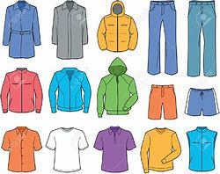
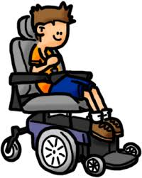
Pictures for Conversations

Slide 9
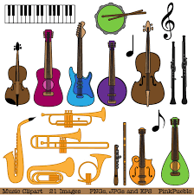
Pictures for Conversations

Slide 10
Assessment Question Prompts
Phrased as if talking directly with the individual, where an advocate is answering on their behalf to rephrase as ‘Tell me about [name]’, ‘what is working well for [name]’ etc. to keep the focus on the individual being discussed. You may also need to rephrase to use language the individual will understand better.
Eligibility Domains
Informal support
Work and learning
Who visits you frequently? How often?
Is there anyone who helps you out? What do they help you with?
Could they be supported to help out with more? What would they like to be able to do?
Are you currently involved in any work (paid or unpaid) or learning opportunities?
If no, Is this something you would like to be able to do?
If yes, how do you access these opportunities?
What would you like to be able to do that you are unable to do at present?
Was/is making a contribution important to you? Can you think of a way that you could do so now?
Being part of your community
What are your particular interests or activities?
How have you been able to pursue these? Does anyone support you with this?
Do you feel part of the community? What about online? If not how do you think you could become involved?
What would you like to be able to do? How do you think you could do this?
Caring for someone else
Are you responsible for the care of someone else as a parent or carer?
How are you currently able to fulfil this role?
Who supports you with this at the moment? Even if just occasionally
What would you like to be able to do for/with them that you are unable to do at present?
Friends and family
You mentioned about [friend or family member], how do you keep in contact with them?
Do you regularly meet or communicate with other people? What do you do to ensure that you do? What could you do to more of this?
Is there anyone you wish to have better contact with? How do you think you could do this?
Running and maintaining your own home
How are you currently able to run your home? What do you do for yourself?
Who supports you at the moment? Even if just occasionally
What would you like to be able to do that you are unable to do at present?
What do you think would support you to do that?
What support are you able to draw on?
Notes:
This is in line with the adult care assessment and eligibility domains. Examples of questions to extra information but remain as a conversation.

Slide 11
Assessment Question Prompts
Phrased as if talking directly with the individual, where an advocate is answering on their behalf to rephrase as ‘Tell me about [name]’, ‘what is working well for [name]’ etc. to keep the focus on the individual being discussed. You may also need to rephrase to use language the individual will understand better.
Eligibility Domains
Using the toilet
Managing your actions
Are you able to manage your own toileting needs? Does this differ when you are not at home?
Are there particular times when you manage better than others? What is it that makes it better / worse?
How would you like to manage your toileting needs?
What / Who do you think can support you with this?
Do you feel in control of your actions, either physical or emotional?
It sounds like you have tried very hard to manage this situation, what do you think has helped you to do that?
What works well?
What works less well and how could this be made better?
Getting dressed
Eating and Drinking
How do you currently get your self dressed/undressed and ensure that you are appropriately addressed for the weather / days activity?
Do you use any tools to help you get dressed? How does this support you?
What would you like to be able to do that you are unable to do at present?
What do you think would support you to do that?
Tell me how you prepare your meals and ensure that you get enough to eat and drink. Does anyone help you with this?
Do you have variety in the meals that you eat? If yes, how are you achieving this? If no, what is stopping you from doing so?
Do you think you could become more independent with the right support?
Maintaining Personal Care with Choice and Dignity
Keeping yourself safe
Tell me how you move around both at home and when you are out and about – what methods of transport do you use? What aids do you use, if any?
Tell me how you manage your personal hygiene. What is your routine in the morning and evening before you go to bed?
What would you like to be able to do that you are unable to do at present?
What do you think would support you to do that?
Including risks from hazards, self-neglect and others:
Tell me how you support yourself with this risk?
What has worked well?
What is difficult for you to achieve?
Do you think you could become more independent with the right support?
Notes:
Can also use these with a support worker or family and re-phrase these.

Slide 12
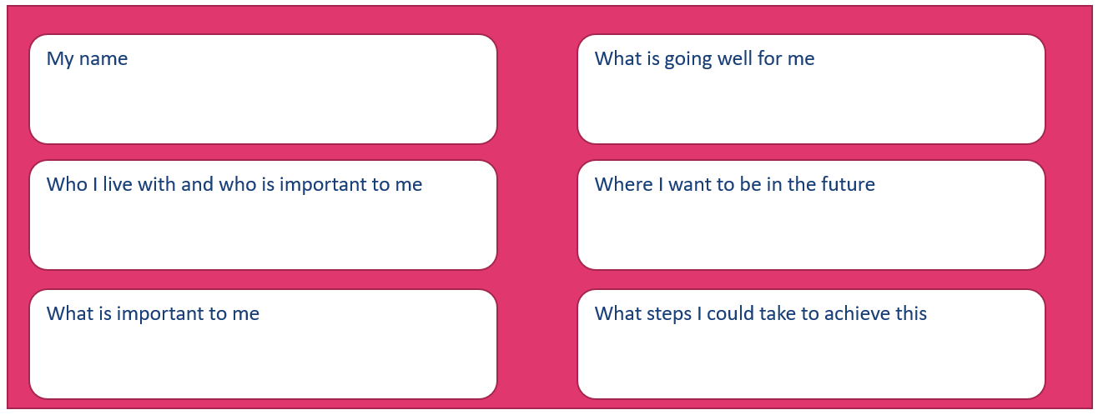
During a Conversation – Communication Tool

Slide 13
During a Conversation – Communication Aids
Yes
I agree
Slow down
I don’t understand
Stop
I would like to speak

Slide 14
During a Conversation – Communication Aids
Good day
Bad day
Important to me
Important for me
Notes:
Can be creative with this, use pictures or draw, have the person draw or with a support worker/family

Slide 15
Tools | Strengths Based Language
Avoiding Dependency Generating Words:
Need
Help
Care
Assessment
Limitation
Struggle
Services
Have to…
Using Independence Focussed Language:
Independent/ Secure/ Well/ Safe
Community/ Neighbourhood/ Local
Family and Friends/ Network/ Social Network
Keep Doing/ Reinforce/ Maintain/ Sustain
Develop/ Establish/ Progress/ Promote/ Expand
Achieve/ Reach/ Realise/ Follow through/ Attain
Goal/ Intent/ Benefit/ Thrive/ Easier/ Simpler
Ability/ Capability/ Strength/ Skill
Able/ Ready/ Capable
Know/ Understand/ Recognise
Support/ Assist
Confident/ Sure/ Positive/ Self sufficient/ Trust (Entrust)/ Expect/ Assured.
Notes:
Steering away from deficit based language

