Slide 1



Workforce development Plan

Slide 2
Index
Page Number | Section Title
2 | Index
3 | Introduction
4 | Management and Staffing Structure
5 | Multi-disciplinary Team
6 | Recruitment and Selection
7 | Staff Skill Base and Qualifications
8 | Induction Programme
9 | Mandatory Training
10 | Training Programme
11 | Arrangements for Supervision and Performance Management
12 | Staff Contingency Arrangements
13 | Management Development and Succession Planning

Slide 3
Introduction
This Workforce Development Plan has been developed to ensure that KITES Children’s Services always has the optimum number of workers in our homes and school, with the right up to date knowledge and skills in place.
The main purpose of this Workforce Development Plan is:
To set out the staff requirements and criteria for in respect of each home and school.
To ensure business continuity plans are not undermined by the failure to retain or recruit key staff.
To anticipate the problems of potential excesses or deficits in employee numbers and plan to minimise the impact on business effectiveness.
Set out the offering regarding its workforce development, training, and support.
Ensure the organisation takes actions to always ensure it has the workforce it needs.

Slide 4
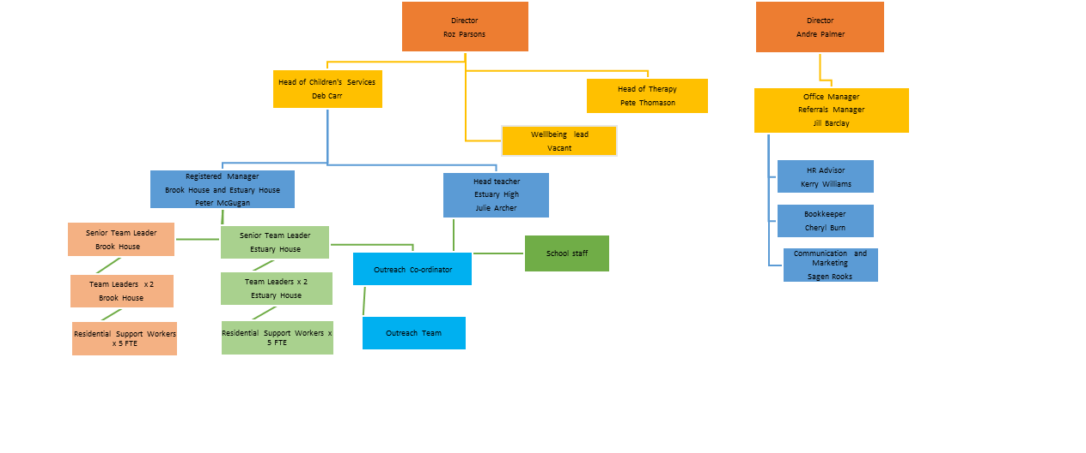
Management and Staffing Structure

Slide 5
Multi-disciplinary Team
The services benefit from the provision of a multi-disciplinary team of professionals who support the young people with therapeutic input and support the staff with strategies for supporting the young people.
Our team is comprised of highly trained and experienced residential, therapeutic and educational practitioners, working together to provide an integrated and diverse programme of assessment and intervention designed to promote and enable the development of pro-social attitudes and behaviours, interpersonal and independence skills and other attributes key to maturation and life quality.
Our model of intervention centres on the G.E.T. I.T. framework, which is a contemporary, research led approach designed to ensure that treatment plans are continually relevant to the young person's individual needs and development:
The G.E.T. I.T Approach
  G stands for the Good Lives Model
  E stands for Evaluation of Risk
  T stands for the Thrive model of integrated, multi-departmental support and intervention
  IT stands for Integrated Treatment

Slide 6
Recruitment and Selection
Our most valuable resource is its employees, and the process of recruiting new people into the Company and ensuring that the right people are recruited into the right posts is arguably the most important activity undertaken by the Company.
We have a detailed Recruitment Policy that sets out the processes to be followed when recruiting and gives guidance on the legal and ethical constraints to be observed. The recruitment process aims to ensure that individuals are treated on their merits and abilities.
It is imperative that we ensure that the policy and procedures are sufficiently rigorous and robust to support other safeguarding and safer recruitment measures undertaken by the Company. It is important that we take reasonable steps to guard against the employment of individuals who might harm children and Kites Children's Services is committed to such a process.

Slide 7
Staff Skill Base and Qualifications
Please see separate training matrix and staffing lists for all staff, their training and qualifications.
It is our aim to continue to develop our staff to ensure continuity and better outcomes for our young people.

Slide 8
INDUCTION PrOGRAMME
All staff are provided with an Induction programme prior to commencing work. They complete 2 days at Head Office prior to working within the home or school. The purpose of this programme is to ensure that all staff receive the basic induction and mandatory training required for the role, to ensure that new starters are familiar with our mission and ethos. It also provides the opportunity to clarify expectation and to ensure that boundaries of professional behaviour are maintained. The programme consists of the following training modules:
Week 1 | Subject | Facilitator | Location
Day 1 | Welcome and Introduction Wellbeing Code of Conduct and Expectations Safeguarding and Child Protection | Director Head of Children's Services and Registered Manager/Headteacher Head of Children's Services | Head Office
Day 2 | ClearCare When I Work Recording and Reporting Risk Assessment | Outreach Co-ordinator Registered Manager | Head Office
Day 3 | GETIT Harmful Sexual Behaviour and Risk Management | Head of Therapy and Registered Manager | Head Office
Day 4 | Shadowing within the home/school, 5-week Induction checklist commences and Mandatory online courses. | Registered Manager / Headteacher | Within the home or school
Day 5 | Shadowing within the home/school, 5-week Induction checklist commences and Mandatory online courses. | Registered Manager / Headteacher | Within the home or school
Week 2 to 5 | Continue 5-week Induction checklist and mandatory online courses | Registered Manager / Headteacher | Within the home or school

Slide 9
Mandatory Training
All staff are required to complete a series of mandatory training courses within 6 months of commencing employment, in order to comply with current legislation and the regulations for Children’s Homes and to ensure that our young people are cared for by staff with relevant and up-to-date knowledge. Including:
Safeguarding and Child Protection
Harmful Sexual Behaviour
CSE
Radicalisation and Extremism (PREVENT)
Equality and Diversity
Countering Bullying
Fire Safety
First Aid
Food Safety and Hygiene
Health and Safety including COSHH
Administration of Medication
Reporting and Recording
Risk Management
Internet Safety
SHADES De-escalation and Physical Intervention Training
Autism
Behaviour that Challenges

Slide 10
Training programme
All staff receive regular supervision, performance management and attend team meetings.
Additional training is undertaken to ensure that the staff within each home can meet the needs of the young people within the home. This includes a mixture of online, face to face training and workshops and cover care planning, keyworker role, self-harming behaviours, behaviour that challenges, ODD and other conduct disorders, additional risk management, the role of the LADO, the role of the police, care standards, education standards, legislation, leadership and management, supervision, and the role of Ofsted to name a few.
If required staff will be enrolled on NVQ L3
All senior team leaders and team leaders are encouraged to undertake NVQ L5 when ready.

Slide 11
Arrangements for supervision and performance management
All staff receive regular individual supervision with new staff having more frequent supervisions during the first six months.
We aim to give agency staff supervision after each eight shifts worked except where they are working more frequently when they will have supervision monthly.
All staff have informal supervision where needed.
Staff receive performance reviews at 3 months, 6 months and 12 months in their first year. Targets are set and agreed for the following 12 months and reviewed at 6 months.

Slide 12
Staff contingency Arrangements
We have a large staff group across both homes who operate under the same ethos and methods of working. Whilst, for continuity of staff for the young people and keyworker sessions, we prefer to have the staff named at each home, it is possible for them to be able to work at both homes when necessary.
We have also recruited a number of 'bank staff' that can be used when there is a shortage of staff.

Slide 13
Management development and succession planning
We are acutely aware of the shortages of registered managers within the industry and therefore we have created an accountability programme to develop all staff.
All senior team leaders and team leaders will undergo additional leadership and management development though regular supervision, appraisal, training and workshops.
We will encourage all senior team leaders and team leaders to undertake formal leadership and management qualification

