Slide 1
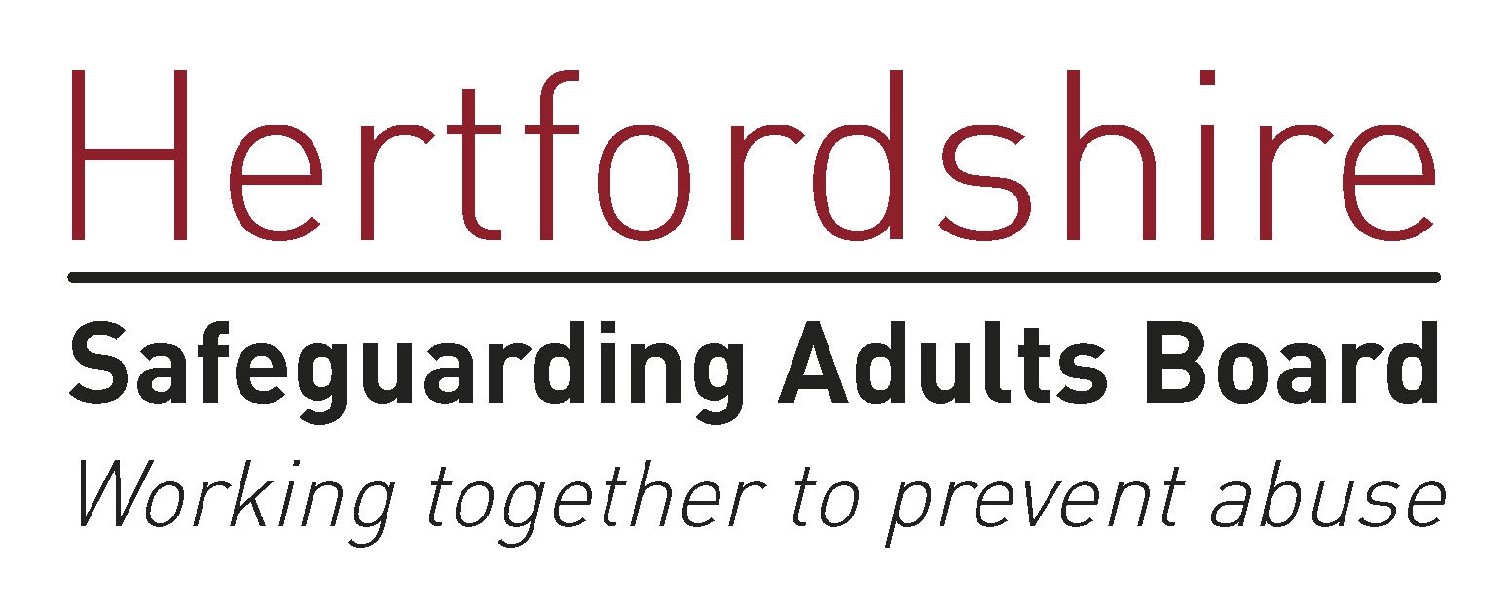
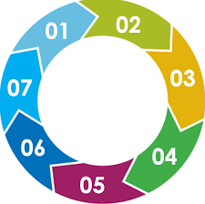
Fire Safety – 7 Minute Briefing
Fire Safety 7 MINUTE BRIEFING - To be shared at Team Meetings
All public sector organisations have a duty under the Care Act 2014 to work effectively and in partnership to ensure that adults can continue living independently in their own home for as long as possible. There are some steps we can all take to support people we work with to reduce the risk of fire and be safer in their homes.
Safe and Well Visits from Hertfordshire Fire and Rescue Service can be requested by anyone.
All professionals can refer people for advice on fire safety.
To make a referral click on this link on the HCC website.
Some people may prefer to do their own fire safety checks. This links gives advice on how to do this Hertfordshire Fire and Rescue Service
OR
Fire and Rescue Service colleagues can have these discussions if you refer the person (with their consent) for a Safe and Well Visit
Please visit our Fire Safety Briefing for more information.
Homes of older people, people with disabilities, those with visual and hearing impairments, and people using drugs or alcohol may need greater consideration when it comes to fire safety.
There are four key reasons why:
· They may not be able to respond to a fire as quickly
· They may not be able to escape a fire
· They may be more at risk due to health needs or lifestyle factors
· They may use healthcare equipment such as oxygen or emollient creams that are flammable (such as E45 cream and Doublebase gel)
Risk Factors to consider: Smoking, people who have a lot of belongings, specialist health equipment, emollient skin creams and restricted mobility.
If the person is cared for in bed or spends most of their time in a chair, they are particularly at risk. Consider their needs and make sure appropriate measures are taken so they can safely escape if there is a fire. Refer them to Safe and Well for expert advice.
Some behaviours at home can increase fire risk. Have a look around and take note of:
· Smoking – unsafe practice for example smoking in bed, unsafe disposal of cigarettes, burn or scorch marks on clothing, flooring or furniture
· Use of emollient creams (lotions, creams or gels that are used to prevent dry skin)
· Use of air pressure mattress or oxygen cylinders
· Unsafe use of heaters for example placed too close to furniture or other items that can catch fire
· Unsafe cooking habits for example cooking left unattended
· Overloaded electrical sockets/adaptors or extension leads
· Faulty or damaged wiring
· Electric blankets
· Previous fires or signs of near misses

