Slide 1
Durham County Council
Health and Safety Team
Supported Lodging Induction Training
Children and Young People’s Services
03000 265 781

Slide 2
Topics being covered today
Health and Safety in the Home
Hazard Identification
Classification of Hazards in the Home
Control Measures
Hazardous Substances
Electrical Safety
Food Safety & Hygiene
Electrical Safety
Fire Safety

Slide 3
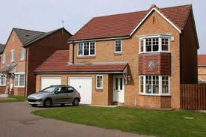
Health and Safety in the Home

Slide 4
Facts & Figures
  More accidents happen at home than anywhere else (2.7 million)
  Every year there are approximately 6,000 deaths as a result of a home accident
  More accidents happen in the lounge/living room than anywhere else in the home
  Falls are the most common accidents, which can cause serious injury
  Children under the age of five and people over 65 (particularly over 75) are most likely to have an accident at home

Slide 5
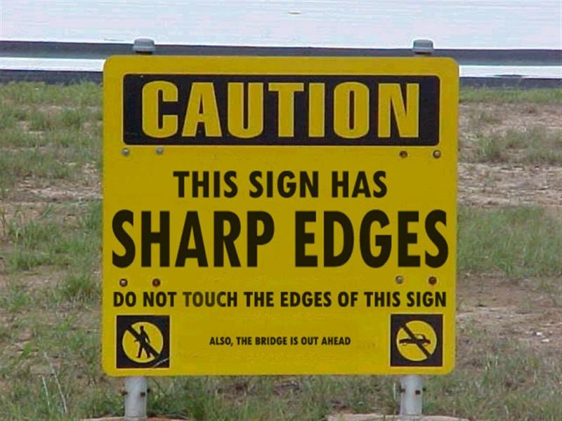
Hazard Identification

Slide 6
Hazard and risk
Hazard - The potential to cause harm
Risk - The likelihood of that harm occurring

Slide 7
In Groups identify Hazards that may be in your home

Slide 8
Common Hazards in Homes
Gas (Cookers/Boilers/BBQ’S).
Slips Trips and Falls (Poor Housekeeping/Worn Carpets/Poorly fixed Banister Rails. Poor lighting levels.
Fire (Poor Housekeeping/Flammables stored close to a source of ignition.
Electricity (Damaged flex/Overloaded plugs/Damaged Equipment.
Chemicals/Substances (Household chemicals/ Prescription drugs).
Environmental (Pathways leading to the home/garden areas/communal areas shared in multi occupancy). Poor lighting levels in and around the home. Building in poor state of repair. Passive smoking.

Slide 9
Control Measure
A method of reducing the risk associated with a Hazard.
Eliminate
Reduce
Isolate
Control
PPE
Discipline (Notices/Instructions)

Slide 10
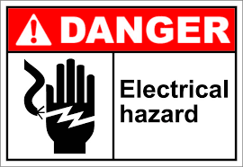
In Groups Identify some Control Measures you can use
Something that can be done to reduce the possibility of an accident

Slide 11
How do we control Hazards in the Home?
Gas Appliances – Annual Servicing/Carbon Monoxide detectors/adequate Ventilation. Follow manufacturers instructions.
Electricity – Fuse Boxes/Circuit Breakers/Residual Current Devices/Visual Inspection. Follow manufacturers instructions.
Fire – Smoke Detectors/Keeping doorways clear/Good Housekeeping/Safe use of Candles etc.
Chemicals/Substances – Adequate storage. Disposal of unwanted substances. Follow directions for use.
Slip/Trip/Fall/ Environmental – Ensuring that maintenance is carried out as and when required. Awareness of weather etc. Ensuring adequate lighting is in place. Reduce clutter. Clean up spills quickly

Slide 12
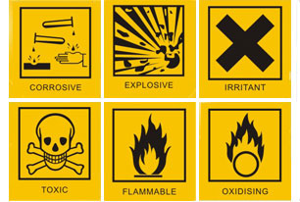
What Hazardous Substances are in the Home?
Most commonly accessed include:
Bleaches
Oven Cleaners
Descalers
Hydrogen Peroxide
Acetone
They can be
Corrosive, Harmful, Irritant or Toxic.

Slide 13
What do we look for?
Signs and symbols on packaging
Labels on containers
Age limitations for use
Dosage/Frequency
Side Affects
Instructions for safe use
Storage Instructions

Slide 14
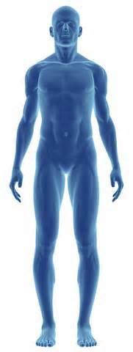
Routes of Entry
Chemicals only harmful if on or in the body. Routes of entry:-
Contact with skin or eye
Breathe in
Swallow
Puncture/inject

Slide 15



Labelling of Containers
Danger to the environment
Explosive
Harmful

Slide 16




Labelling of Containers
Toxic
Flammable
Corrosive
Oxidising

Slide 17
Asbestos in the Home

Slide 18
Summary
Asbestos is a hazardous material when it is disturbed.
Asbestos materials can be present in buildings built before 2000.
Asbestos was at its peak between 1945 and 1980.
In the UK, there are over nine million houses of this age.

Slide 19
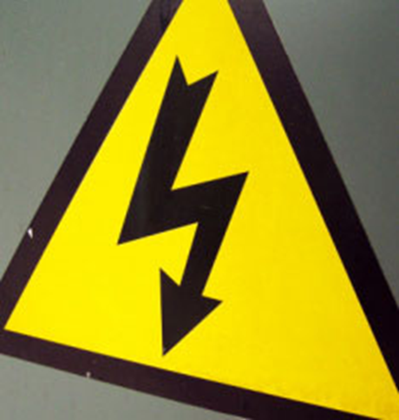
Electrical Safety

Slide 20
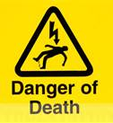
Did you know?
Electric shock occurs upon contact of a (human) body part with any source of electricity that causes a sufficient current through the skin, muscles, or hair.
It always tries to find the easiest path
to the ground.
Human bodies contain 70% water and water conducts electric current really well.
Electricity flows more easily through water than through air.

Slide 21
Statistics
1. Low voltage electrocutions and fatal electrical burns in GB from low voltage electricity supplies (2010 data)
  Total: 28
  Work related electrocutions: 6
  Home or leisure electrocutions: 22
2. Electric shocks:
  People receiving a mains voltage electric shock per year (15+): 2.5 million
  Of whom received a serious injury: 350,000

Slide 22
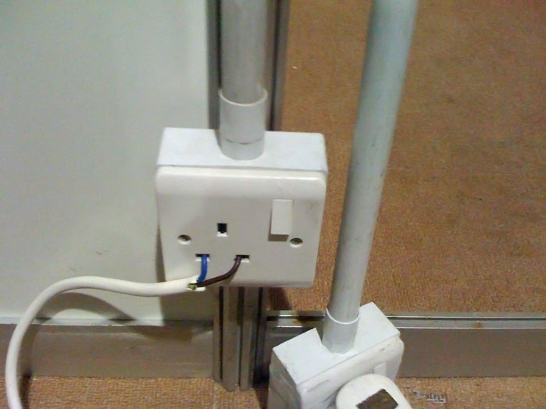
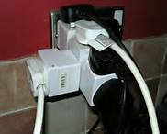
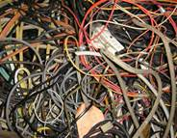
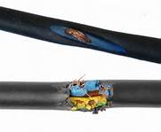
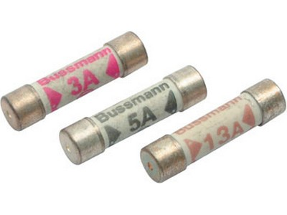
Common Issues
Overloading of electrical circuits
Incorrect wiring of electrical circuits
Incorrect fuse rating
Damaged cabling or equipment
Misuse of equipment

Slide 23
Control Measures
Do not overload sockets
Ensure proper wiring of plugs
Regular checks of equipment, cables and flex’s
Use specialised equipment for damp environments – Bathrooms
Use of correct fuses, light shades, RCD’s, light bulbs and circuit breakers

Slide 24
Food Safety & Hygiene
Keeping your Kitchen Area clean and hygienic
Following good hygiene habits
Staying alert to food safety hazards
Storing food correctly

Slide 25
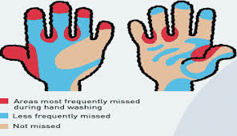
You are the worst thing that comes into contact with food!

Slide 26
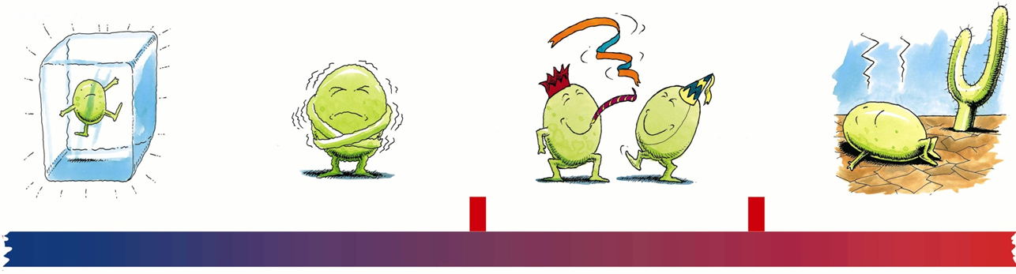
High Risk and perishable foods should be kept out of the Danger Zone between temperatures of 5ºC to 63ºC . Bacteria grows at an alarming rate in this zone.
Foods are likely to be at danger zone temperatures when they are:
Left standing in a room
Left in sunlight, for instance in any window
Heated slowly
Cooled slowly
Danger zone
-18ºC
Freezer
0ºC
Freezing
5ºC
Fridge
37ºC
Body Temp
63ºC
Hot Food
100ºC
Boiling

Slide 27

Fire Safety

Slide 28
Fire Statistics
Durham & Darlington (April 2014 to April 2015)
  County Durham and Darlington Fire and Rescue Service attended 299* dwelling fires.
  * Primary Fire - includes all fires in buildings, vehicles and most outdoor structures or any fire involving casualties, rescues or fires attended by five or more pumping appliances. - See more at: https://www.ddfire.gov.uk/incident-types-we- attend#sthash.bArefwqG.dpuf

Slide 29
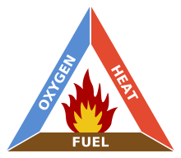
Triangle of fire
In order for a fire to burn 3 elements must be present.
  Fuel: Anything will burn at the correct temperature i.e. Wood, Paper, petrol etc.
  Heat: Any source of heat may be sufficient to start a fire i.e. The Sun, a radiator.
  0xygen: Is always present in the air we breath.

Slide 30
In Groups identify the common causes of property fires

Slide 31
The main causes of fire
  Cooking Appliances
  Other Electrical Appliances
  Smokers Materials
  Electrical Distribution

Slide 32
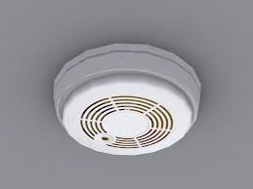
Domestic Smoke Alarms

Slide 33
Why Install a Smoke Alarm?
Each year over 500 deaths and 11,000 injuries occur in fires in the home.
Many of these deaths and injuries could be prevented if people had early warning and were able to get out in time.
Having correctly fitted and operating smoke alarms in your home could help to save your home and lives of your family from fire.

Slide 34
General Information
The ideal locations for smoke alarms are at the top of stairs, on stair landings and between living and sleeping areas.
You should check your alarm
Weekly – Test the battery (using the test button provided on the alarm).
Monthly – Vacuum the alarm to remove dust.
After 10 years – it is best practice to replace the entire system.
For further information contact County Durham and Darlington Fire and Rescue Service Community Safety Team on 0845 2234221 or visit www.ddfire.gov.uk

Slide 35
If there is a fire in your Home
Have a plan – make sure everyone who lives or visits your home knows what to do if there is a fire.
Get out
Stay out
Get the Fire Service out. Dial 999
For further information please visit www.gov.uk/firekills

