Slide 1



CTP ERSOU – BED PREVENT
NRF GUIDANCE
Bedfordshire Prevent Team
Supervisor - A/PS 585 WARNER
CTCOs - Staff 2561 Lena BHOGAITA, Staff 3668 Cema MIAH, PC 1134 JARVIS
OFFICIAL

Slide 2



NOTICE
CHECK
SHARE
OFFICIAL
Notes:
NOTICE : We want colleagues to firstly notice the concern, this could be through what’s been said, what’s they’ve seen, or spotting some of the traits noted within the NRF.
CHECK : Once colleagues have noticed the concern, we want them to CHECK the information they have at hand. This can be by talking with the person about what they have said to explore it. Talking with Safeguarding/Prevent Leads or supervisors to see if they have NOTICED other concerns or what best course of action is. We are always happy to give advice if you are unsure.
SHARE : Once the concern is Noticed and then Checked, then we want colleagues to share the concerns. This is vitally important. If the sharing does not take place, then the risk potentially stays with the person who has the information.
So remember NOTICE, CHECK and SHARE.

Slide 3
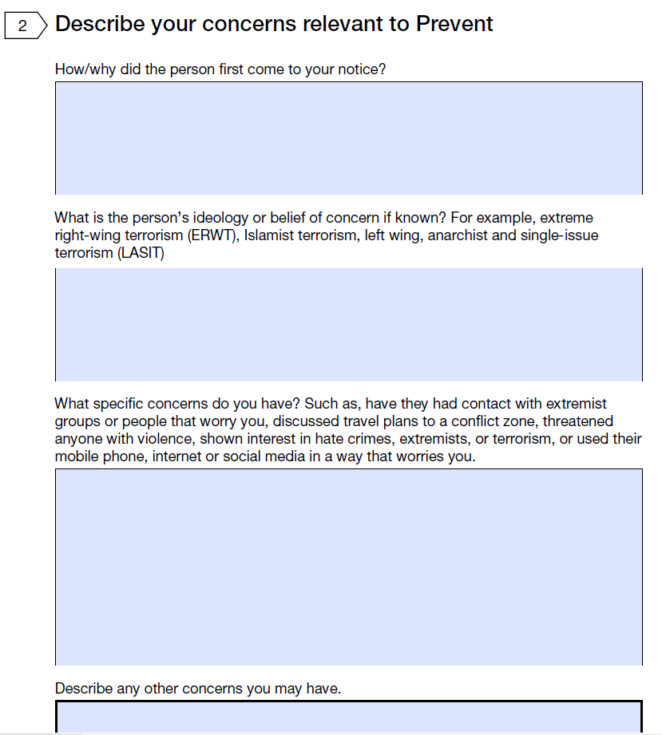
NATIONAL REFERRAL FORM
“Devil is in the Detail”
Here describe how the person first come to your notice – did they attend a clinic, did something happen outside/inside of school etc etc.
Here if you're not sure, put that – its fine. We don’t expect you to have an expert knowledge of different ideological thematics. If you can, explain it in layman terms.
This is where the detail really counts – it gives examples of possible concerns specific to what is making you worried and thinking this is for Prevent.
Last box – this is anything else that might not be for Prevent but is still a concern that you think we need to be aware of.
OFFICIAL

Slide 4
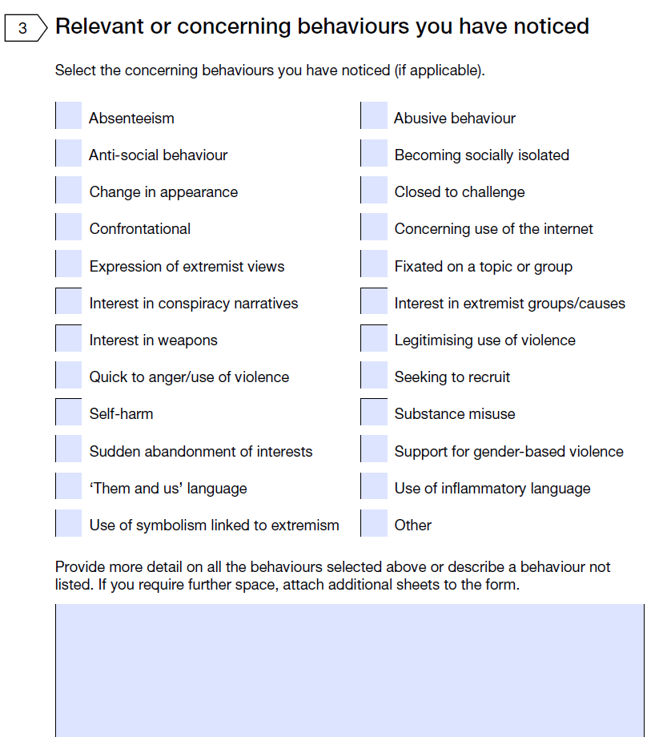
NATIONAL REFERRAL FORM
Select all that apply.
Those that you have selected, please provide the information that supports why you think this is present within the individual
you’re referring
If you Select “Other” please also describe the behaviour noticed.
OFFICIAL

Slide 5
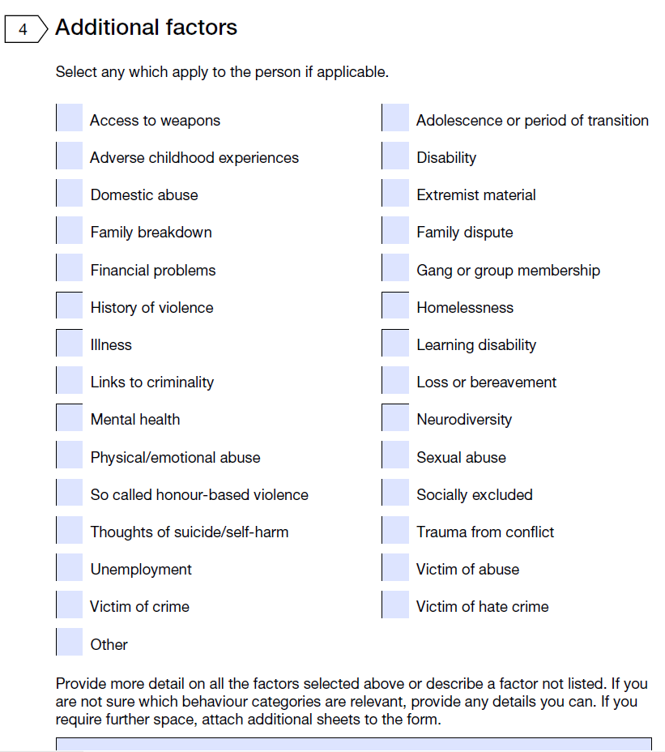
NATIONAL REFERRAL FORM
Select all that apply.
Those that you have selected, please provide the information that supports why you think this is present within the individual
you’re referring.
If you Select “Other” please also describe the behaviour noticed.
OFFICIAL

Slide 6
NATIONAL REFERRAL FORM
General Rule’s:
“Devil is within the Detail”
Leave no box empty – if you don’t know, you don’t know but at least we know that you have considered and not accidentally missed it.
Consider an Adult/Children Protection Referral
Contact us for advice if your unsure: prevent@beds.police.uk
SUBMIT TO: preventreferrals@beds.police.uk
OFFICIAL

Slide 7
USEFUL LINKS
Get help for radicalisation concerns - GOV.UK
Contains support and advice – NRF can be downloaded from here but please use the copy provided as it has the correct email address and is more friendly in filling out.
Educate Against Hate - Prevent Radicalisation & Extremism
Aimed at the Education centre but can be a use resource particularly when it comes to CHECKing the concern i.e tips for talking to people and how best to approach.
ACT Early | Prevent radicalisation
Another useful site with resources – tips for talking etc.
OFFICIAL

Slide 8
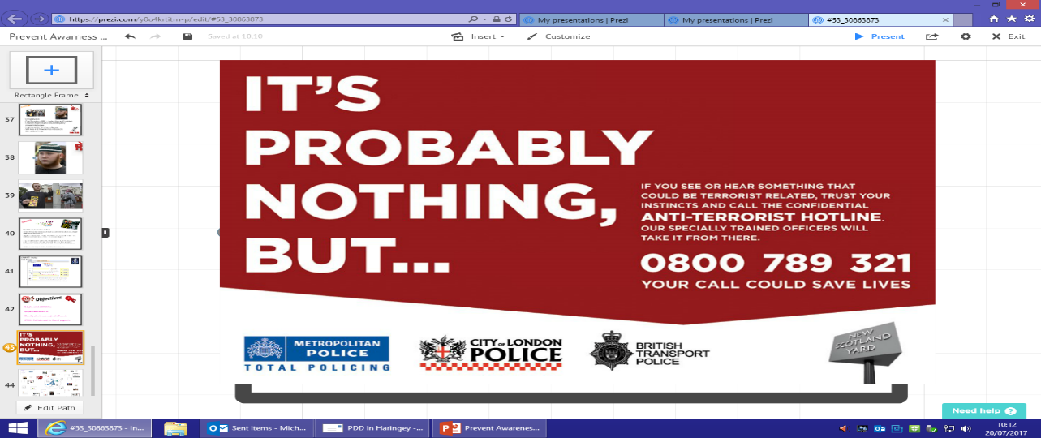

Think safeguarding think Prevent
Advice and guidance can be sought from your Prevent officers:
Prevent@beds.police.uk
Referrals Only:
Preventreferrals@beds.police.uk
www.actearly.uk
OFFICIAL

